Slide 1
Lab 6 – Review DQN and DDPG
Speaker: 何國豪
Authors: 何國豪、鄭余玄

Slide 2
DRL Techniques Related to Heavy-Weight Model Applications
Preliminary
Value-Based
Deep Q-Learning: DQN
Policy-Based & Actor-Critic
DDPG (Deep Deterministic Policy Gradient)

Slide 3
Preliminary

Slide 4
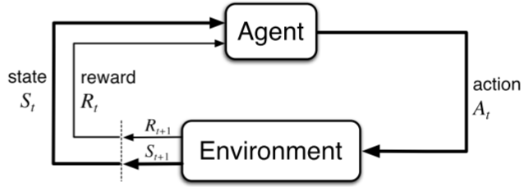
Agent-Environment Framework
Agent:
The learner and decision-maker
Environment:
The thing the agent interacts with, comprising everything outside the agent
State (S_{t}):
Whatever information is available to the agent at time t
Action (A_{t}):
The action the agent applies to the environment at time t
Reward (R_{t}):
The numerical values as the feedback for taking the previous action (A_{t-1}) to the current state (S_{t})

Slide 5
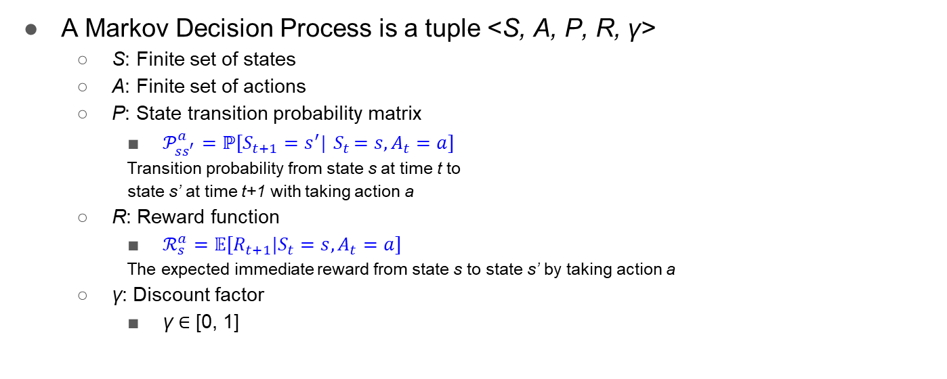
Markov Decision Process (MDP)

Slide 6

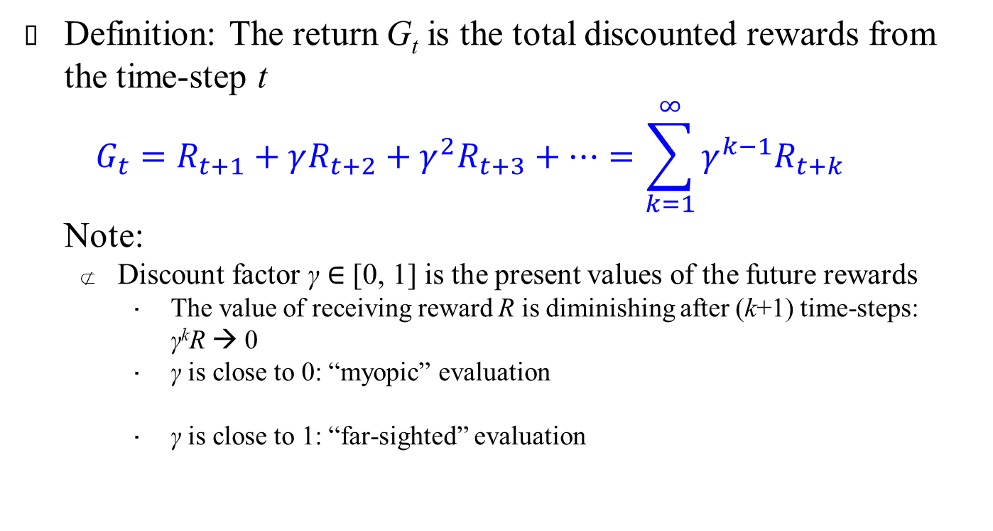
Return
Definition: The return G_{t} is the total discounted rewards from the time-step t $G_{t}=R_{t+1}+γR_{t+2}+γ^{2}R_{t+3}+…=\sum_{k=1}^{∞}{γ^{k−1}R_{t+k}}$ Note:
Discount factor γ ∈ [0, 1] is the present values of the future rewards
The value of receiving reward R is diminishing after (k+1) time-steps: γ^{k}R → 0
γ is close to 0: “myopic” evaluation
γ is close to 1: “far-sighted” evaluation
γ = 0 → G_{t} = R_{t+1}
γ = 1 → G_{t} =$\sum_{k=t+1}^{T}{R_{k}}$
$$A_{t}$$
$$A_{t+1}$$
$$A_{T−1}$$
$$S_{t}$$
$$S_{t+1}$$
…
$$S_{T−1}$$
$$S_{T}$$
$$R_{t+1}$$
$$R_{t+2}$$
$$R_{T}$$

Slide 7
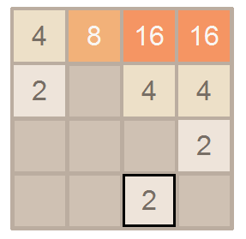
RL Agent’s Target
The agent’s target is to maximize the return
Decide an action by the agent’s policy for maximum return in each state
RL is a way to train an agent’s policy
Value-Based
E.g.: 2048 Take the action with maximum scores (with agent’s expectation) Assume: Left → Final score = 900 Right → Final score = 1500 Up and down → Final score = 0 ➔ Take right

Slide 8
RL Agent’s target
The agent’s target is to maximize the return
Decide an action by the agent’s policy for maximum return in each state
RL is a way to train an agent’s policy
Value-Based
Policy-Based:
E.g.: Rock-Paper-Scissors Policy A: 100% Rock, 0% for Paper and Scissors Policy B: 33% for Rock, Paper and Scissors Policy B is better than Policy A [A good policy is to take each action with 1/3 chance]

Slide 9
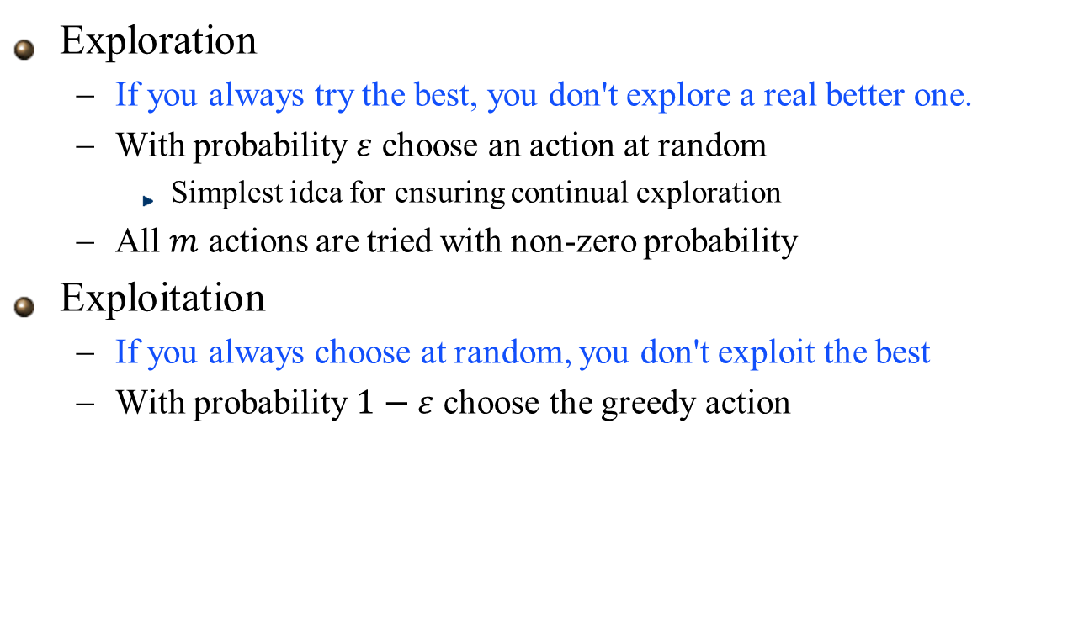
Exploration vs. Exploitation
Exploration
If you always try the best, you don't explore a real better one.
With probability $ε$ choose an action at random
Simplest idea for ensuring continual exploration
All $m$ actions are tried with non-zero probability
Exploitation
If you always choose at random, you don't exploit the best
With probability $1−ε$ choose the greedy action
greedy: 每次都選最大的 state-action value => 只有 Exploitation
epsilon-greedy: 有 epsilon 機率任意選動作 => 兩者兼顧

Slide 10

Value-Based and Policy-Based RL
Value-Based
Learnt Value Function
Implicit policy (e.g. $ε$-greedy)
Policy-Based
No Value Function
Learnt Policy
Actor-Critic
Learnt Value Function
Learnt Policy

Slide 11
Value-Based: DQN

Slide 12

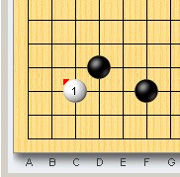
Deep Q-Learning Network (DQN)
Past work (before NN raising):
Q-Learning with manual features
E.g.: 我師父說: AK不賭是棒槌
Need domain knowledge to design the features
Bias for the features
E.g.: Go, “點33”不好
點33(白)

Slide 13
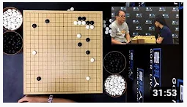
Deep Q-Learning Network (DQN)
點33(白)
Past work (before NN raising):
Q-Learning with manual features
Need domain knowledge to design the features
DQN:
Deep: Use neural network (NN) to extract the feature
Q-Learning: Value-based approach
With NN:
Extract the feature by NN
No bias
E.g.: AlphaGo, “點33”也有不錯的下法

Slide 14
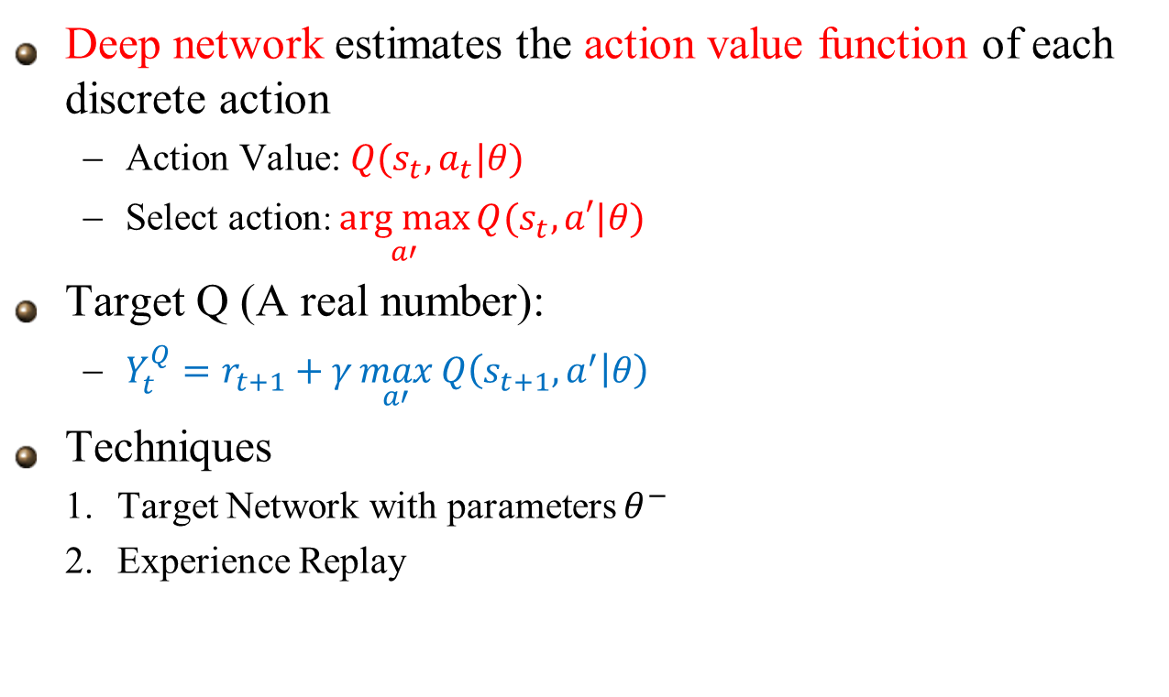



Deep Q Network (DQN)
Deep network estimates the action value function of each discrete action
Action Value: $Q(s_{t},a_{t}|θ)$
Select action: $\underset{a′}{arg max}{Q(s_{t},a′|θ)}$
Target Q (A real number):
$Y_{t}^{Q}=r_{t+1}+γ\max_{a′}{Q\left(s_{t+1},a^{′} | θ\right)}$
Techniques
Target Network with parameters $θ^{−}$
Experience Replay
DQN $$θ$$
$$Q(s,a_{1}|θ)$$
State s
$$Q(s,a_{n}|θ)$$
Notes:
NN is used as a non-linear function approximator

Slide 15
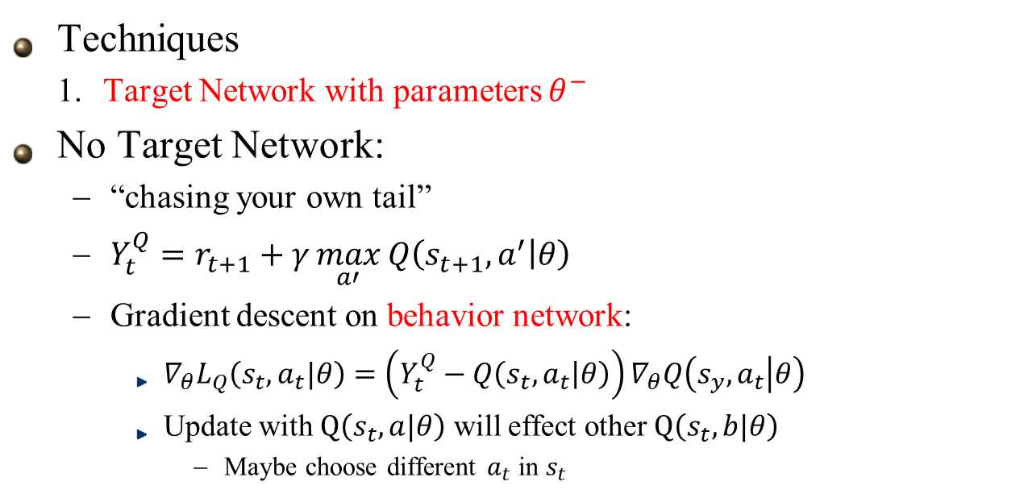




Deep Q Network (DQN)
Techniques
Target Network with parameters $θ^{−}$
No Target Network:
“chasing your own tail”
$Y_{t}^{Q}=r_{t+1}+γ\max_{a′}{Q\left(s_{t+1},a^{′} | θ\right)}$
Gradient descent on behavior network:
$∇_{θ}L_{Q}\left(s_{t},a_{t}|θ\right)=\left(Y_{t}^{Q}−Q\left(s_{t},a_{t} | θ\right)\right)∇_{θ}Q\left(s_{y},a_{t} | θ\right)$
Update with $Q\left(s_{t},a|θ\right)$ will effect other $Q\left(s_{t},b|θ\right)$
Maybe choose different $a_{t}$ in $s_{t}$
Update
a
A
$$Q\left(s_{t},a|θ\right)$$
$$Q′\left(s_{t},a|θ^{′}\right)$$
S
Also effect b
b
B
$$Q\left(s_{t},b|θ\right)$$
$$Q′\left(s_{t},b|θ^{′}\right)$$

Slide 16


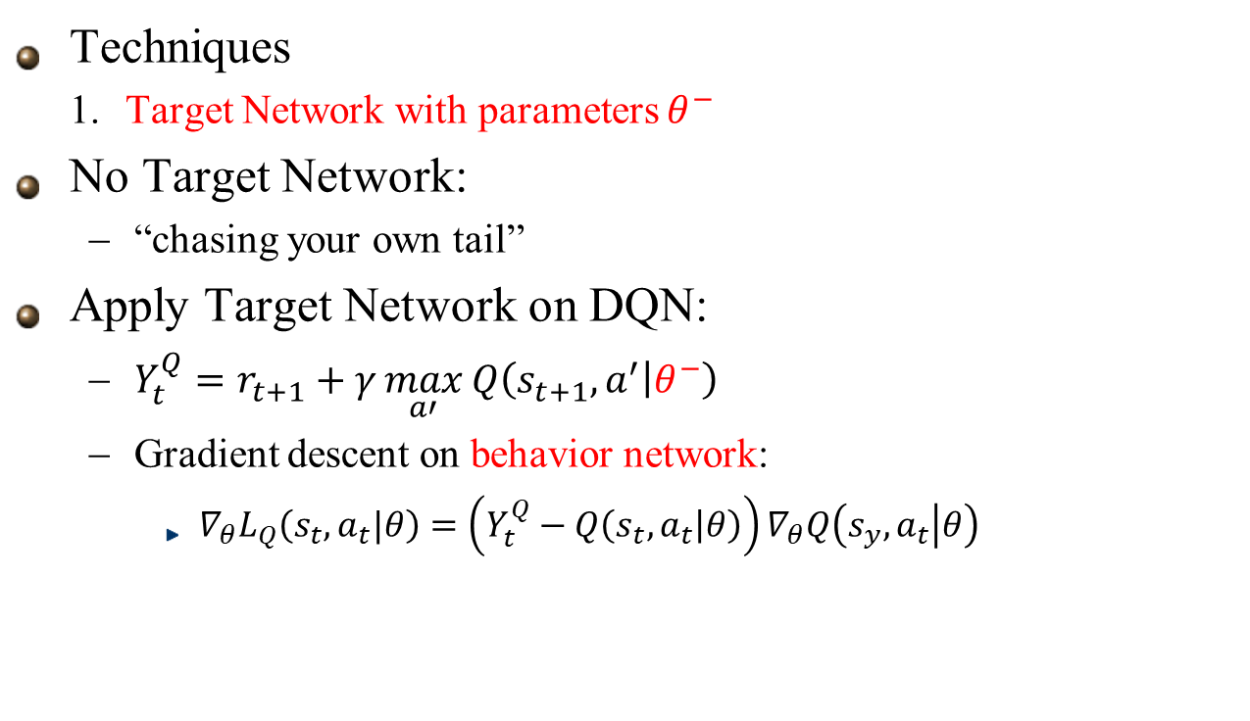











Deep Q Network (DQN)
Behavior
Network $$θ$$
$$Q(s,a_{1}|θ)$$
Techniques
Target Network with parameters $θ^{−}$
No Target Network:
“chasing your own tail”
Apply Target Network on DQN:
$Y_{t}^{Q}=r_{t+1}+γ\max_{a′}{Q\left(s_{t+1},a^{′} | θ^{−}\right)}$
Gradient descent on behavior network:
$∇_{θ}L_{Q}\left(s_{t},a_{t}|θ\right)=\left(Y_{t}^{Q}−Q\left(s_{t},a_{t} | θ\right)\right)∇_{θ}Q\left(s_{y},a_{t} | θ\right)$
State s
$$Q(s,a_{n}|θ)$$
Copy $θ$ every
N iterations
Target
Network $$θ^{−}$$
$$Q(s,a_{1}|θ^{−})$$
State s
$$Q(s,a_{n}|θ^{−})$$
$$Q\left(s_{t},a|θ\right)$$
Update
$$Q′\left(s_{t},a|θ^{′}\right)$$
a
A
$$Q\left(s_{t},a|θ^{−}\right)$$
S
Still effect $Q′\left(s_{t},a|θ^{′}\right)$ But for gradient calculation, use none effect $Q\left(s_{t},a_{t}|θ^{−}\right)$
b
$$Q\left(s_{t},b|θ\right)$$
B
$$Q\left(s_{t},b|θ^{−}\right)$$

Slide 17

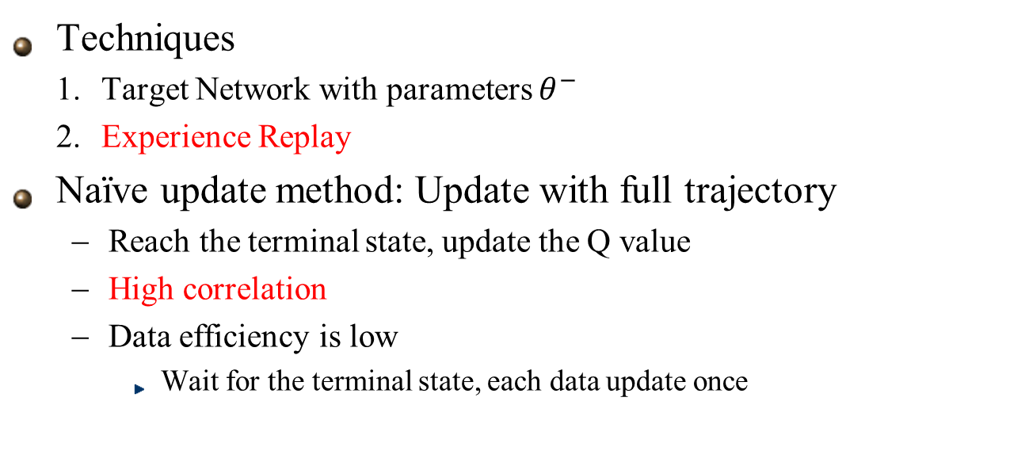












Deep Q Network (DQN)
Techniques
Target Network with parameters $θ^{−}$
Experience Replay
Naïve update method: Update with full trajectory
Reach the terminal state, update the Q value
High correlation
Data efficiency is low
Wait for the terminal state, each data update once
$$A_{1}$$
$$A_{t}$$
$$A_{t+1}$$
$$A_{T−1}$$
$$S_{1}$$
…
$$S_{t}$$
$$S_{t+1}$$
…
$$S_{T−1}$$
$$S_{T}$$
$$R_{2}$$
$$R_{t+1}$$
$$R_{t+2}$$
$$R_{T}$$
Update

Slide 18
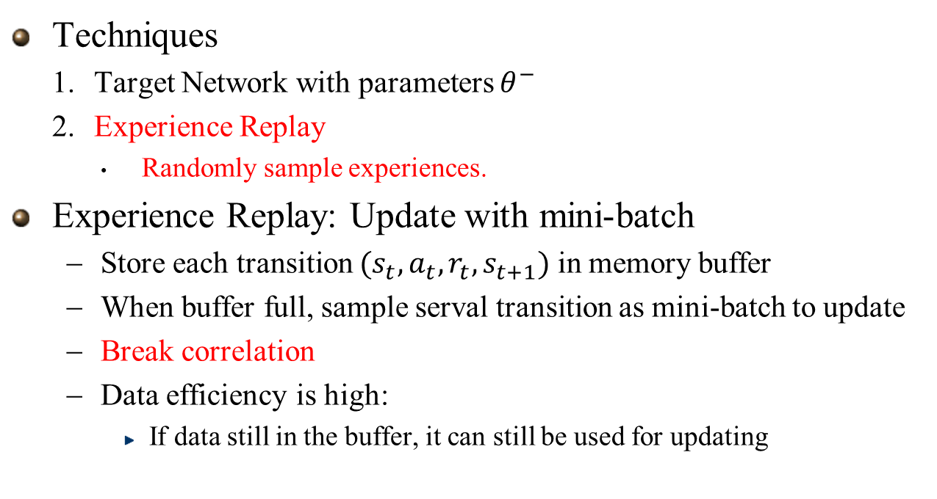
Deep Q Network (DQN)
Techniques
Target Network with parameters $θ^{−}$
Experience Replay
Randomly sample experiences.
Experience Replay: Update with mini-batch
Store each transition ${(s}_{t},a_{t},r_{t},s_{t+1})$ in memory buffer
When buffer full, sample serval transition as mini-batch to update
Break correlation
Data efficiency is high:
If data still in the buffer, it can still be used for updating
$$A_{1}$$
$$A_{t}$$
$$A_{t+1}$$
$$A_{T−1}$$
$$S_{1}$$
…
$$S_{t}$$
$$S_{t+1}$$
…
$$S_{T−1}$$
$$S_{T}$$
$$R_{2}$$
$$R_{t+1}$$
$$R_{t+2}$$
$$R_{T}$$
Update
Update

Slide 19
Deep Q Network (DQN)
Summary:
Use neural network to extract the features for Q-learning
2 key points:
Target Network: Overcome “chasing your own tail” problem
Experience Replay: Break correlation, more data efficiency
DQN $$θ$$
$$Q(s,a_{1}|θ)$$
State s
$$Q(s,a_{n}|θ)$$

Slide 20
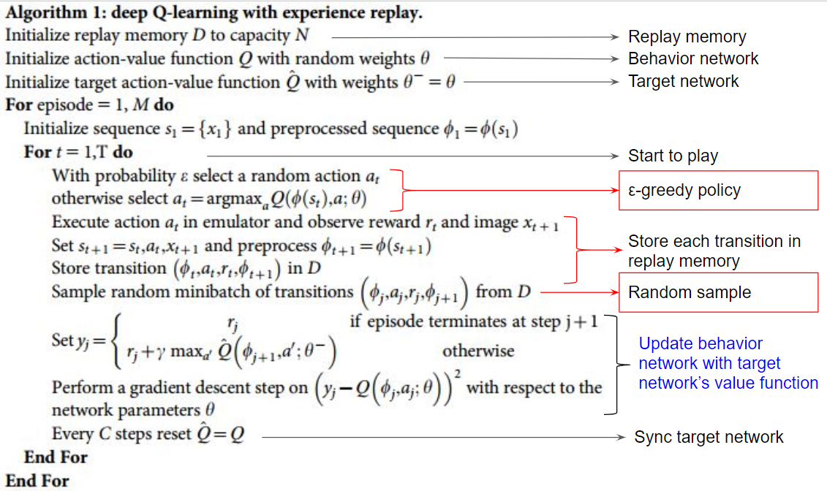

Slide 21
From Value-Based to Policy-Based

Slide 22
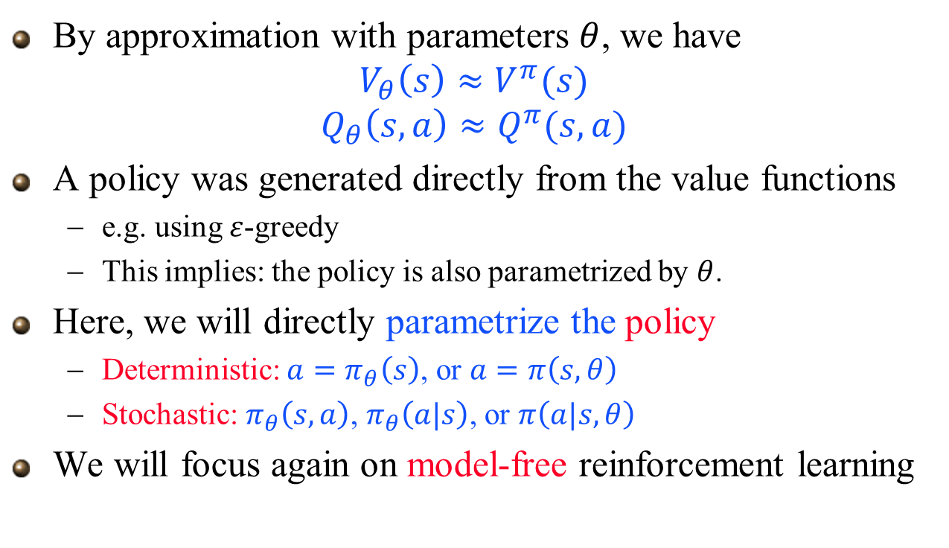
Policy-Based Reinforcement Learning
By approximation with parameters $θ$, we have
$$V_{θ}\left(s\right)≈V^{π}(s)$$
$$Q_{θ}\left(s,a\right)≈Q^{π}(s,a)$$
A policy was generated directly from the value functions
e.g. using $ε$-greedy
This implies: the policy is also parametrized by $θ$.
Here, we will directly parametrize the policy
Deterministic: ${a=π}_{θ}\left(s\right)$, or $a=π\left(s,θ\right)$
Stochastic: $π_{θ}\left(s,a\right)$, $π_{θ}\left(a|s\right)$, or $π\left(a|s,θ\right)$
We will focus again on model-free reinforcement learning

Slide 23
Advantages of Policy-Based RL
Advantages:
Better convergence properties
Effective in high-dimensional or continuous action spaces
Can learn stochastic policies
Disadvantages:
Typically converge to a local rather than global optimum
Evaluating a policy is typically inefficient and high variance

Slide 24
Deep Deterministic Policy Gradient (DDPG)
(Actor-Critic in continuous action space)

Slide 25
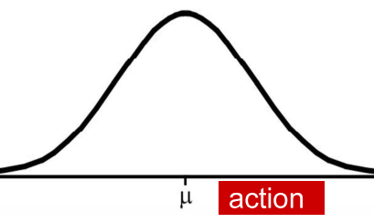
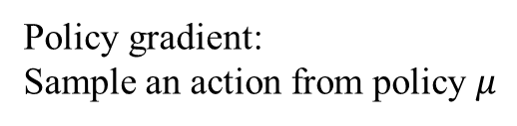

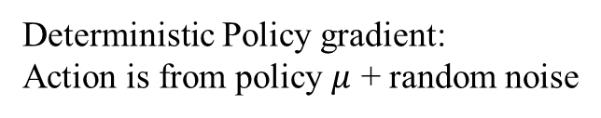
Deep Deterministic Policy Gradient
Deep: Use neural network to extract features
Deterministic: Use policy result + noise as the selected action (noise for exploration during training)
Policy gradient: Policy-Based method
Deterministic Policy gradient: Action is from policy $μ$ + random noise
Policy gradient: Sample an action from policy $μ$
$$a_{t}=μ(s_{t}|θ)$$
Noise

Slide 26




Deterministic Policy Gradient
Deterministic policy gradient can be estimated more efficiently, especially in high-dimensional continuous action spaces
Deterministic policy integrates over only states space
Use off-policy learning to ensure adequate exploration
Actor $$θ$$
State s
$$μ\left(s | θ\right)$$
$$Action a$$
State s
Critic $$ω$$
$$Q(s,a|ω)$$
Action a

Slide 27
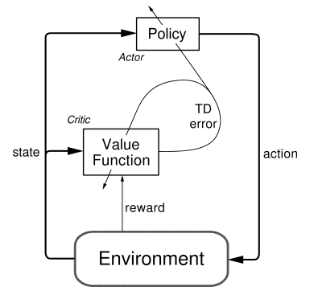
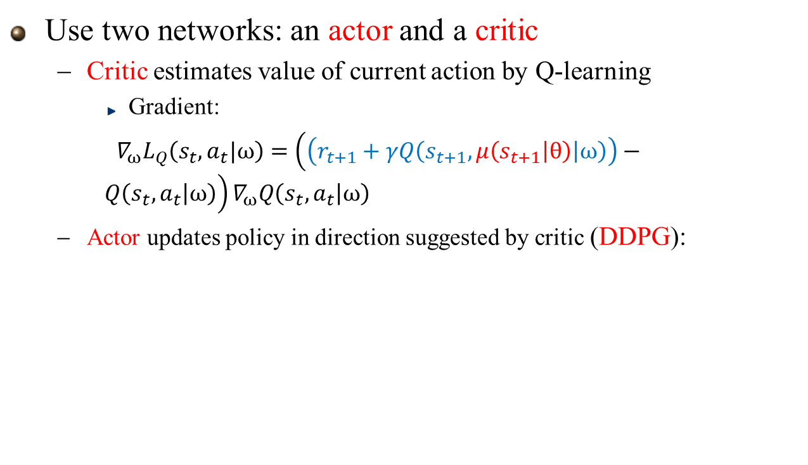
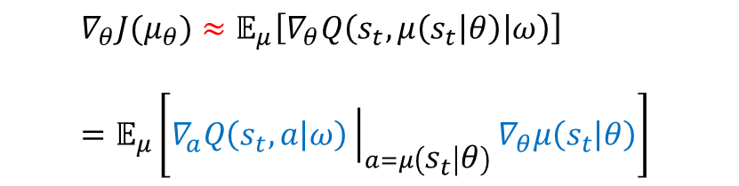
Deep Deterministic Policy Gradient (DDPG) (A Kind of Actor-Critic For Continuous Actions)
Use two networks: an actor and a critic
Critic estimates value of current action by Q-learning
Gradient:
$∇_{ω}L_{Q}\left(s_{t},a_{t}|ω\right)=\left(\left(r_{t+1}+γQ\left(s_{t+1},μ\left(s_{t+1} | θ\right) | ω\right)\right)−Q\left(s_{t},a_{t} | ω\right)\right)∇_{ω}Q\left(s_{t},a_{t} | ω\right)$
Actor updates policy in direction suggested by critic (DDPG):
$$∇_{θ}J(μ_{θ})≈𝔼_{μ}\left[∇_{θ}Q\left(s_{t},μ\left(s_{t} | θ\right) | ω\right)\right]$$
$$=𝔼_{μ}\left[∇_{a}Q\left(s_{t},a | ω\right){\left.​\right|}_{a=μ\left(s_{t} | θ\right)}∇_{θ}μ\left(s_{t} | θ\right)\right]$$
Actor $$θ$$
State s
$$μ\left(s | θ\right)$$
$$Action a$$
State s
Critic $$ω$$
$$Q(s,a|ω)$$
Action a
Notes:
Why deterministic Policy Gradient doesn’t need to do Importance sampling? (Check )

Slide 28
Deep Deterministic Policy Gradient (Continuous Action Space)
Summary:
Use two networks
Actor: Agent’s policy Interact with environment Update Actor with policy gradient by Critic’s suggestion
Critic: Policy evaluation Judge how good the selected action is Update Critic with TD error with selected action by Actor

Slide 29
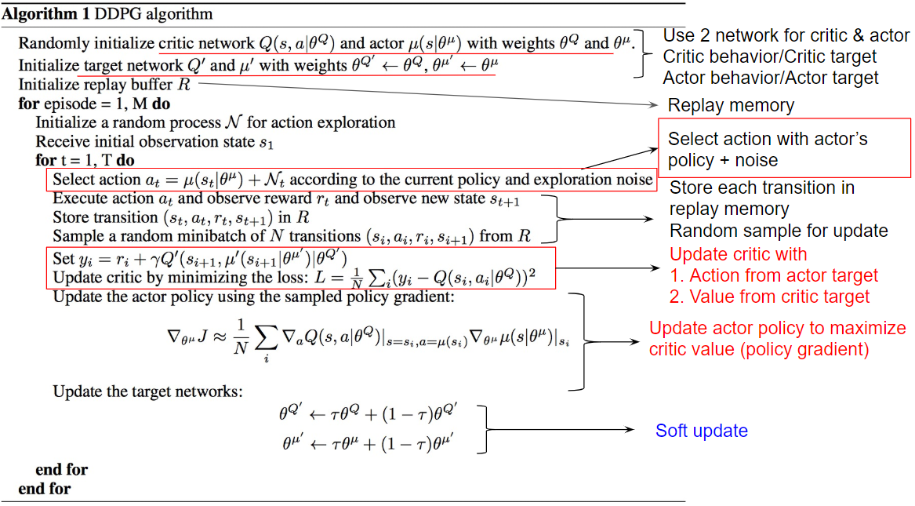

Slide 30
Appendix

Slide 31
Simple Actor-Critic

Slide 32
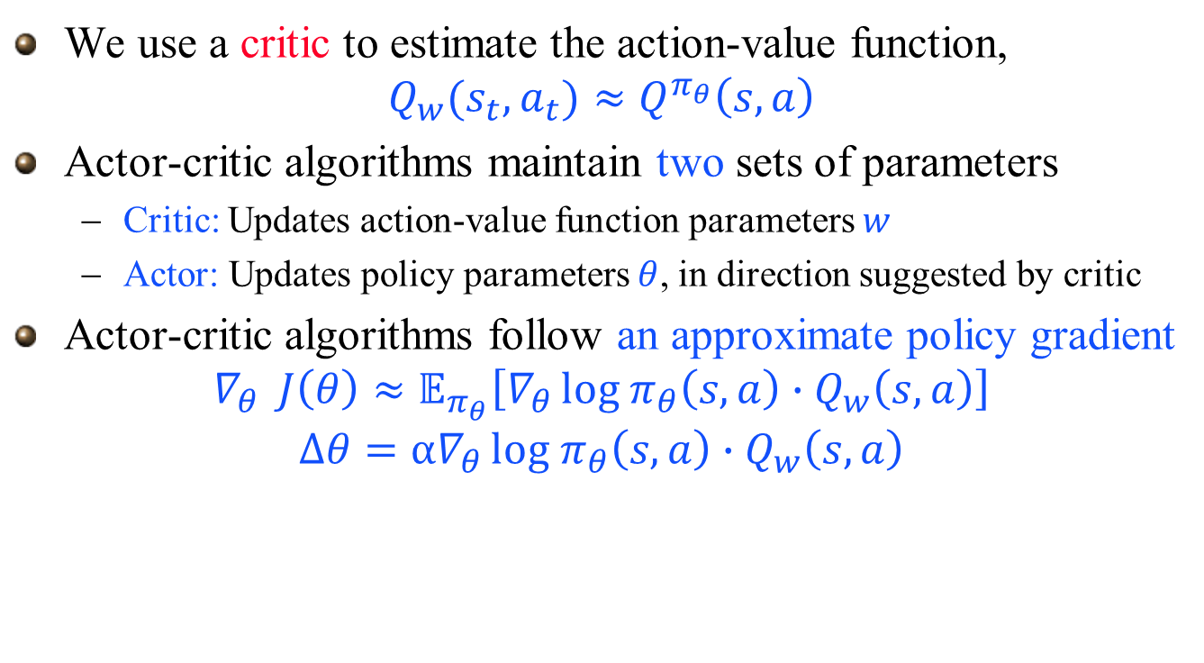
Reducing Variance Using a Critic
We use a critic to estimate the action-value function,
$$Q_{w}(s_{t},a_{t})≈Q^{π_{θ}}\left(s,a\right)$$
Actor-critic algorithms maintain two sets of parameters
Critic: Updates action-value function parameters $w$
Actor: Updates policy parameters $θ$, in direction suggested by critic
Actor-critic algorithms follow an approximate policy gradient
$$∇_{θ } J\left(θ\right)≈𝔼_{π_{θ}}\left[∇_{θ }{log π}_{θ}\left(s,a\right)∙Q_{w}\left(s,a\right)\right]$$
$${∆θ=α∇}_{θ }{log π}_{θ}\left(s,a\right)∙Q_{w}\left(s,a\right)$$

Slide 33


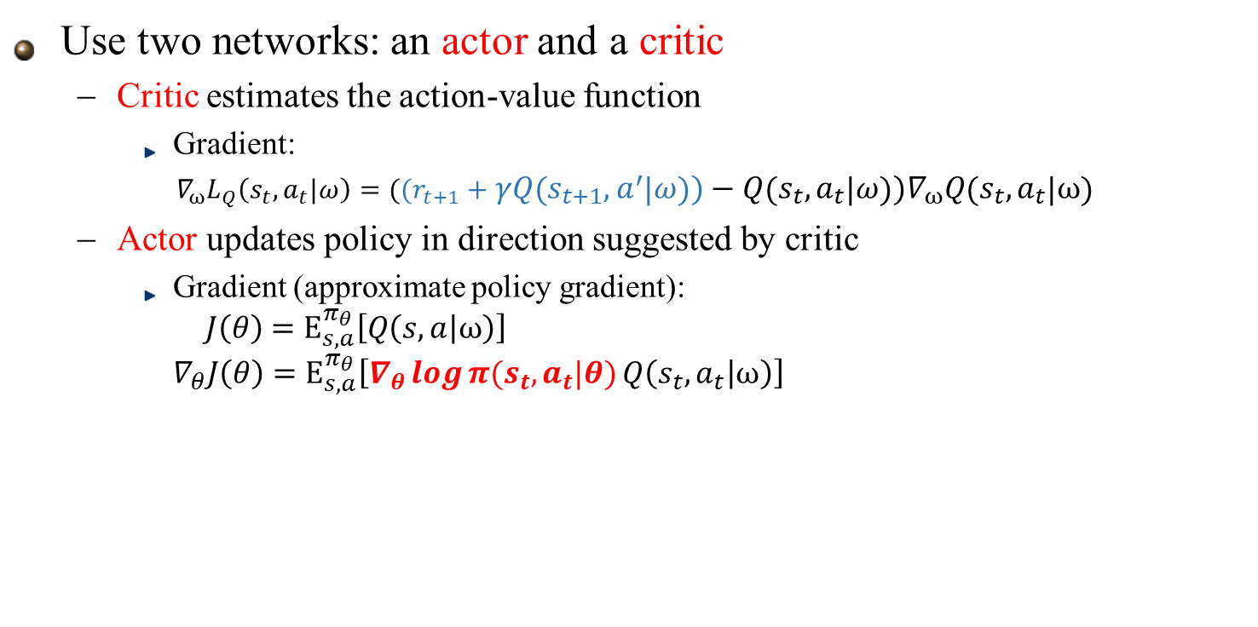



Actor-Critic (Discrete Action Space)
Use two networks: an actor and a critic
Critic estimates the action-value function
Gradient:
$∇_{ω}L_{Q}\left(s_{t},a_{t}|ω\right)=((r_{t+1}+γQ\left(s_{t+1},a^{′} | ω\right))−Q\left(s_{t},a_{t} | ω\right))∇_{ω}Q\left(s_{t},a_{t} | ω\right)$
Actor updates policy in direction suggested by critic
Gradient (approximate policy gradient): $J\left(θ\right)$ $=E_{s,a}^{π_{θ}}\left[Q\left(s,a | ω\right)\right]$ $∇_{θ}J\left(θ\right)$ $=E_{s,a}^{π_{θ}}\left[∇_{θ}\log{π(s_{t},a_{t}|θ)}Q\left(s_{t},a_{t} | ω\right)\right]$
Actor $$θ$$
$$π(s,a_{1}|θ)$$
State s
Critic $$ω$$
State s
$$Q(s,a|ω)$$
$$π(s,a_{n}|θ)$$
Action a
Sample an action

Slide 34
Actor-Critic (Discrete Action Space)
Summary:
Use two networks
Actor: Agent’s policy Interact with environment Update Actor with policy gradient by Critic’s suggestion
Critic: Policy evaluation Judge how good the selected action is Update Critic with TD error with selected action by Actor (sample an action)

